Slide 1

ChurnInsight AI:
Predictive Analytics for Customer Retention in Banking
Presented by: Aiswaryaa Velumani Sai Teja Aggunna Shrinisha Nirmalkumar Vaishnavi Pathipati

Slide 2




Introduction: Tackling Customer Churn with AI
The Problem
Customer churn is a critical issue in the banking sector, directly affecting profitability and long-term relationships. Losing existing clients is costly, especially when coupled with the expense of acquiring new customers. Traditional approaches often fail to detect churn early, leaving banks vulnerable to high attrition rates.
The Solution
ChurnInsight leverages machine learning to predict customer churn by analyzing behavior and demographic data. Algorithms like Random Forests and Decision Trees provide early warnings for at-risk clients. This enables banks to take proactive, targeted retention measures, improving customer loyalty and profitability.
The Approach
We developed a structured pipeline involving data cleaning, feature engineering, and predictive modeling. Our evaluation focused on metrics like F1 Score and ROC-AUC to ensure accuracy and reliability. This process helped us deliver actionable insights for addressing churn effectively and efficiently.

Slide 3
Dataset: Behind the Data Curtain
Data Collection:
The dataset, sourced from Kaggle, includes information on 10,000 customers from ABC Multinational Bank. It contains 14 attributes such as age, balance, and customer engagement behavior, providing a detailed view of customer dynamics.
Data Cleaning:
Class Balancing:
Data Analysis:
The dataset was thoroughly checked for null values and duplicates to maintain data quality and integrity. Outliers were managed to ensure the dataset was clean and ready for analysis.
The class distribution was analyzed to identify imbalances between churned and non-churned customers. Techniques like SMOTE (Synthetic Minority Oversampling Technique) were applied to balance the classes.
Data distributions were visualized using heat maps and box plots to uncover correlations and trends, such as the impact of age, balance, and tenure on churn likelihood.
Data Splitting:
Hyperparameter Tuning:
Model Comparison:
The dataset was split into training (80%), validation (10%), and testing (10%) sets. Stratified sampling was applied to maintain the original class distribution in all subsets, ensuring reliable model evaluation and generalizability.
To improve the performance of our models, we applied Grid Search for hyperparameter tuning. This method systematically explores different combinations of parameters to identify the best-performing configuration for each algorithm.
Models like Logistic Regression, Decision Trees, Random Forests, and XGBoost were compared to select the best-performing model based on evaluation metrics.

Slide 4
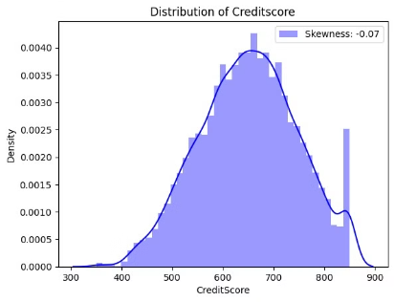
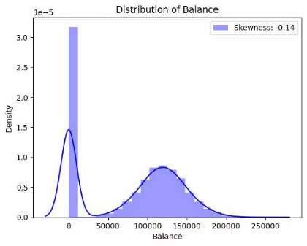
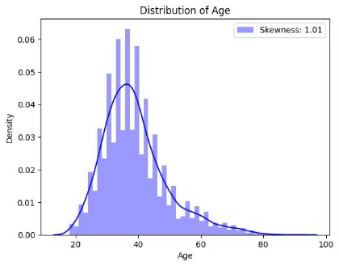
Data Analysis & Preprocessing
This analysis explores various factors contributing to customer churn at the bank, utilizing heat maps, bar charts, and box plots for a comprehensive examination of
the correlations and distributions of customer attributes.
Figure 1: Density plots showing right-skewed customer balance, uniformly distributed salaries, left-skewed credit scores, and right-skewed age.

Slide 5
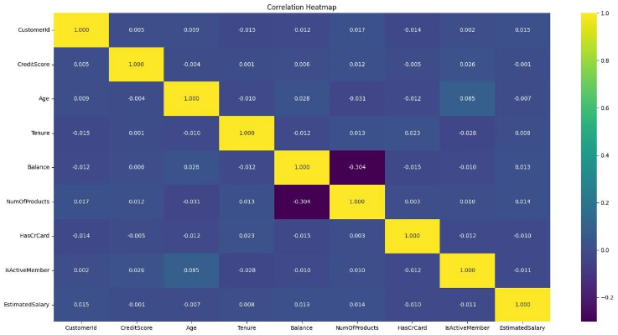
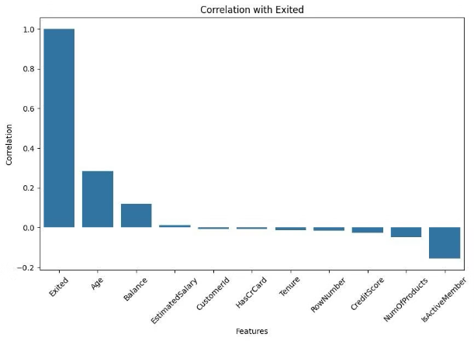
Detailed Correlation Analysis
The heat map (Figure 2) and bar chart (Figure 3) clearly illustrate key correlations:
Figure 2: Heat map illustrating the correlation between customer attributes.
Figure 3: Bar chart illustrating the strength of correlation between various factors and customer churn

Slide 6
Methodology: Blueprint to Prediction
Below are the machine learning models used for churn prediction, along with why they were chosen and how they were applied:
Logistic Regression
Reason: Simple and effective baseline for binary classification.
Usage: Provides feature importance insights for model comparison.
k-Nearest Neighbors (k-NN)
Reason: Simple and effective for predicting churn by comparing customer similarities.
Decision Trees
Usage: Classifies customers based on the majority class of their nearest neighbors in the feature space
Reason: Offers interpretability and captures non-linear patterns.
Usage: Highlights key churn-related attributes with clear decision paths.
Random Forests
Reason: Reduces overfitting and improves accuracy through ensemble learning.
XGBoost
Usage: Combines multiple decision trees, optimized via hyper-parameter tuning.
Reason: Delivers high accuracy and handles imbalanced data effectively.
Usage: Focuses on misclassified samples, boosting prediction precision.

Slide 7

Navigating through Challenges
Class Imbalance
Feature Identification
Model Interpretability
The dataset was heavily imbalanced, with the majority customers classified as non-churned and few as churned. This imbalance risked the model becoming biased towards predicting the majority class, leading to poor performance in detecting churned customers.
Selecting the right features was challenging due to the mix of categorical and numerical data with complex correlations. The model has sometimes been risked into underperforming or overfitting by providing noise or less relevant attributes.
Understanding the right model and tuning its hyper-parameters was challenging due to the varying performance of models under different conditions and hyperparameter tuning required significant time and computational resources.

Slide 8




Adaptations: Smart Moves
Class Balancing
We have balanced the dataset by using SMOTE and generating synthetic samples for churned customers to improve model sensitivity and accuracy.
Feature Engineering
By Appling one-hot encoding for categorical variables and even normalised numerical data to ensure consistency and compatibility across features.
Model
Interpretability
We have used Grid Search to improve the model parameters, resulting in improved performance and a better balance of accuracy, precision and recall.

Slide 9
Results:
Performance metrics
MODEL
F1 Score
F1 Score
ROC-AUC Score (Validation)
ROC-AUC Score (Test)
(Validation)
(Test)
KNN
0.47
0.48
0.67
0.69
Logistic Regression
0.62
0.65
0.76
0.76
Decision Trees
0.67
0.67
0.53
0.54
Random Forest
0.72
0.70
0.80
0.79
XG Boost
0.67
0.67
0.63
0.62
Best Model: Random Forest achieved an F1 Score of 0.72 and ROC-AUC of 0.80, outperforming other models.

Slide 10

Future works:
Future development will focus on enhancing the model's predictive capabilities and expanding its functionality. This includes exploring advanced techniques to further improve its predictive accuracy, such as more robust feature engineering and hyperparameter optimization.
Additionally, we plan to investigate the integration of real-time data streams to enable immediate churn risk assessment and proactive intervention. This will allow for dynamic adjustments to marketing and customer service strategies, resulting in more effective churn prevention.

Slide 11

Conclusion
The project highlighted the effectiveness of machine learning in predicting customer churn, by achieving a strong ROC-AUC of 0.80 and an F1 Score of 0.72, leveraging behavioural and historical data.
Future enhancements could include advanced techniques like neural networks, real-time prediction frameworks, and sentiment analysis based on customer input, which will provide deeper insights into customer behaviour and increase applications across industries.

Slide 12
Thank you!!!

